Slide 1
Lamport’s Clock

Slide 2
Time, Order and Events
A distributed system consist of a collection of spatially separated distinct processes which communicate by exchanging messages.
The term event is used to specify occurrence of a single action that a process carries out as it executes.
e.g. Send, Receive, change state
Distributed systems lacks a global time and the local clocks in the computers are unsynchronized.
So it is not possible to order events on different machines using local times
Notes:
We rely a lot on time in our daily existence for ordering. One thing “happened before” another is a relation that is codified by time, using physical clocks as a mechanism to deliver time. So ordering of events is done using physical clocks in the real world. It is possible to form a local order of events in each node. But In a distributed system how can one establish a coherent order of events across multiple nodes. This order is important while accessing shared resources in a distributed system.

Slide 3
Happens before Relation
But under certain conditions it is possible to ascertain order of 2 events based on the underlying computation.
Happens before is a relation that orders events based on underlying computation.
This relation captures the casual dependencies b/w events and denoted using ‘→’

Slide 4
Happens before Relation
For two events a and b,
a → b , if a and b are events in the same process and a occurred before b,
a → b , if a is a send event of a message m and b is the corresponding receive event at the destination process, or
a→b and b→ c, then a-→ c
Event a casually affects event b if a → b

Slide 5
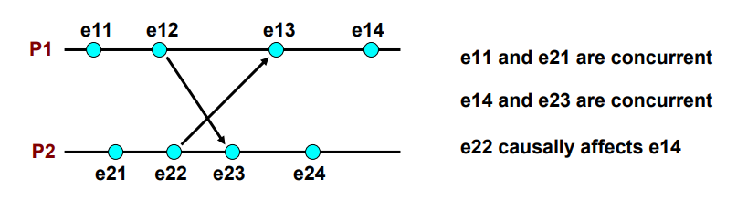
Concurrent Events
Two events a and b are described as concurrent when a hasn’t happened before b and b hasn’t happened before a.(denoted by a||b)
This condition generally reflects the fact that process i may not have knowledge about all events that could have happened in process j.
Notes:
e11 seems to happen before e21,if we were to consider physical time. But in this system, we will call these events as concurrent. Both processes don’t know about these events — there is not causal relationship at this time

Slide 6
Lamport’s Logical Clock
In order to realize the relation ‘→‘ (happens before) Lamport’s introduced the concept of Logical clocks.
There is clock Ci for each process Pi of the system.
The clock Ci can be thought of as a function that assigns a number Ci(a) to any event a ,called the timestamp of the event.
The numbers assigned have no relation to physical time, hence the name logical clock.
The logical clock takes monotonically increasing values and can be implemented using counters

Slide 7
Conditions satisfied by logical clocks
For any 2 events a and b,If a → b , then C(a)<C(b)
The ‘happens before’ relation can be realized using logical clocks, if following 2 conditions are met.
C1: For any two events a and b in a process Pi, if a occurs before b, then
Ci(a)<Ci(b)
C2: If a is the event of sending a message m in process Pi and b is the event of receiving the message m process Pj, then
Ci(a)<Cj(b)

Slide 8
Implementation rules of Logical clocks
The following implementation rules(IR) for clocks guarantee that the clocks satisfy the correctness condition C1 and C2
IR1: Clock Ci is incremented between any two successive events in the process Pi:
Ci:=Ci+d(d>0)
Ie, if a and b are 2 successive events in process Pi and a->b then
Ci(b)=Ci(a)+d

Slide 9
Implementation rules of Logical clocks
IR2: If event a is the process of sending message m by process Pi, then message m is assigned a timestamp tm=Ci(a).
On receiving the message m by process Pj, Cj is set to maximum value of current Cj and timestamp tm of send message
Cj=max(Cj, tm)
Increment Cj with the value d(usually 1) as per IR1
Cj=Cj+d
Notes:
The message recipient event at Pj increments Cj as per IR1 and the updated value of Cj is used in the equation.
when receiving a message (the message must include the senders local clock value) set your local clock to the maximum of the received clock value and the local clock value. After this, increment your local clock by 1

Slide 10
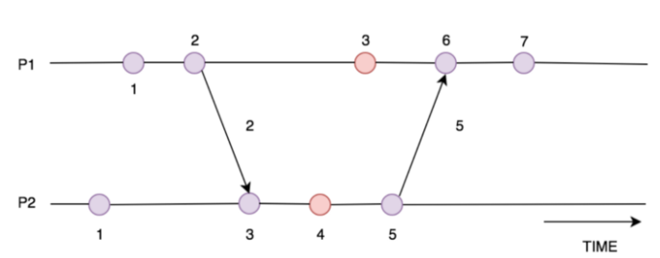
Implementation rules of Logical clocks
Here the send event of P1 is sending a message to P2 Process. The Receive event of Process P2 is invoked, and the clock of P2 is set to the maximum of tm=2 and current Cj=1
Cj=max(1,2)=2
Cj=Cj+1 -> Cj=2+1=3
Notes:
The message recipient event at Pj increments Cj as per IR1 and the updated value of Cj is used in the equation.
when receiving a message (the message must include the senders local clock value) set your local clock to the maximum of the received clock value and the local clock value. After this, increment your local clock by 1

Slide 11
Virtual Time
Lamport’s logical clocks implements an approximation to global/physical time referred to as virtual time.
Virtual time advances along with the progress of events.
If no events occur in the system, virtual time stops unlike physical time which continuously progress.
Therefore to wait for a virtual time instant to pass is risky, as it may never occur.

Slide 12
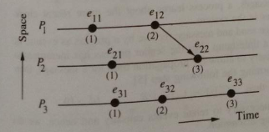
Limitation of Lamport’s clock
In Lamport’s clock if a->b then C(a) < C(b)
But the reverse is not necessarily true(ie,if C(a)<C(b),then a->b) if the events belong to different processes.
Events a and b may or may not be casually related.
Notes:
Here e11 is casually related to e22 as a path exists from e11 to e22.
But even if C(e11)< C(e32), we can’t say that e11 happens before e32 as they belong to different processes.

Slide 13
Vector clock
Introduced to overcome limitations of Lamport’s Logical clock
Each process keeps a vector (a list of integers) with an integer for each local clock of every process within the system.
If there are N processes, there will be a vector of size N maintained by each process.
Eg: If there are 3 processes, each process keeps a vector Ci of size 3 with Ci[1] represents logical clock value for P1, Ci[2] for P2 and Ci[3] for P3

Slide 14
Vector clock: Implementation Rules
R1: before executing an event (excluding the event of receiving a message) process Pi increments the value Ci[i] within its local vector by 1
Ci[i]=Ci[i]+1
R2: when process Pj receives a message from process Pi (the message must include the senders vector) loop through each element in the vector Ci send by Pi and compare it to the local vector Cj, updating the local vector to be the maximum of each element.
Ie, For all k, Cj[k]=max(Cj[k],Ci[k])
Then increment Cj[j] with 1
Cj[j]=Cj[j]+1

Slide 15
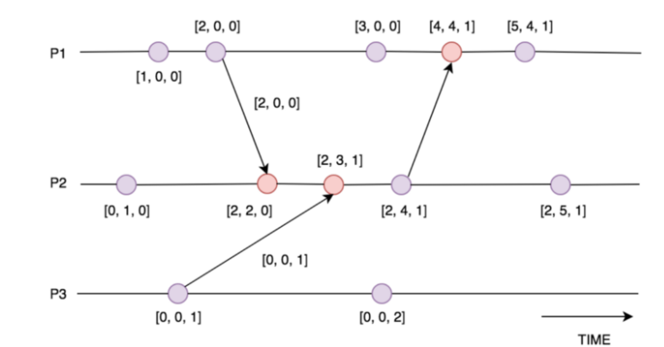
Vector clock: Implementation Rules

Slide 16
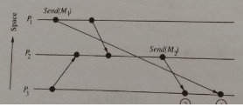
Casual Ordering of Messages
Casual ordering of messages deals with the notion of maintaining the same casual relationship that exists between ‘Message send’ event and ‘Message receive’ event.
If Send(M1)->Send(M2), then every recipient of both the messages must receive M1 before M2.
In distributed systems, casual ordering of messages is not automatically guaranteed.

Slide 17
Casual Ordering of Messages
Several protocols are available to ensure casual ordering of messages in distributed systems.
The commonly used algorithms are:
BIRMAN-SCHIPER-STEPHENSON Protocol
SCHIPER-EGGLI-SANDOZ PROTOCOL
Basic idea of both protocols is to deliver the message to a process if the message immediately preceding it has been delivered to the process
Otherwise message is buffered until immediately preceding message is delivered
A vector accompanying each message provides necessary information to make the decision

